Slide 1
Hack Zika 2016
Digital Mosquito Inspector
By:
John Brock
Sam Harden
Shenole Latimer

Slide 2
Mission Statement
Put mosquito inspectors out of the job.

Slide 3
What we built: Prepare for Buzzwords

Slide 4
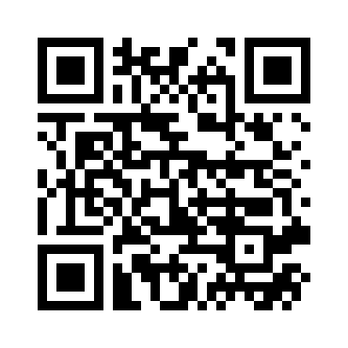
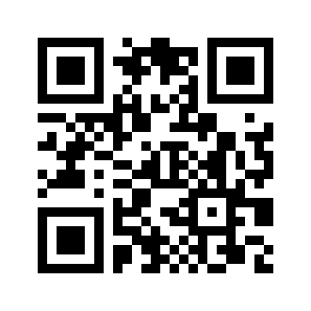
The Websites
Back End:
digital-mosquito-inspector.herokuapp.com
Front End:
s9m00001.site

Slide 5
Features:
Accessible, Easy to Use, Mobile Friendly Interface
User authentication
Checklist Page
More Information Page

Slide 6
Technologies Used:
Ruby on Rails
Bootstrap
Devise
Open Admin
Rspec/Guard and Factory Girl

Slide 7
Future Plans
In the Works:
More Robust Checklists System
Styling
Data collection
Planned Features:
Messaging system
Periodic Reminder System
Scalability

Slide 8
Any Questions?

